Slide 1
The Other Microprocessor for the Apple II
Jay Graham
jwg@pitt.edu

Slide 2
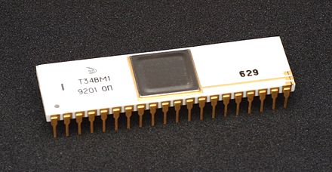
Topics
Brief History
Zilog Z80
CP/M
Apple CP/M Card Solutions
CP/M Software (where to get it)
Software Demo

Slide 3
Zilog Z80 CPU
Federico Faggin
Compatible with the intel 8080
Aimed at Embedded Systems
Introduced 1976
Used in a wide variety of devices
Licensed to Synertec and MOSTek
Improved over the 8080
Notes:
Faggin formed Zilog with Ralph Ungerman. At Fairchild and Intel he worked on the 4004 and the 8080.
Conceived by Federico Faggin in Late 1974
Software compatible extension and enhancement of the intel 8080
Aimed at embedded systems
Official introduced July 1976
Came to be widely used in desktop computers using CP/M
Big in Video Games of the 70s and early 80s
Licensed the manufacture to Synertek and MOSTek
Improvements over the 8080
Enhanced Instruction Set
Better Interrupt System
Less hardware required for power supply, clock, and I/O

Slide 4
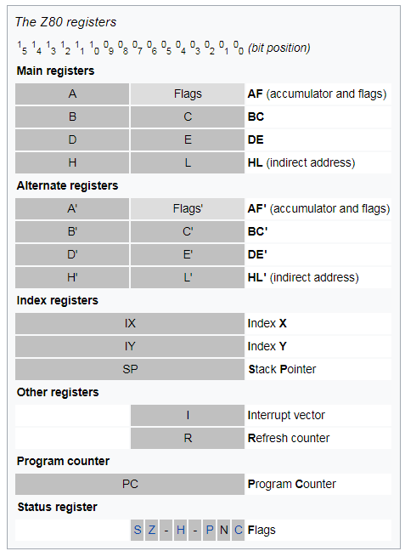
Z80 Registers
Notes:
252 opcodes
8-bit registers are typically paired to provide 16-bit versions
Has a unique "fetch/execute overlapping
Has its own set of undocumented instructions (Illegal Opcodes) and bugs

Slide 5
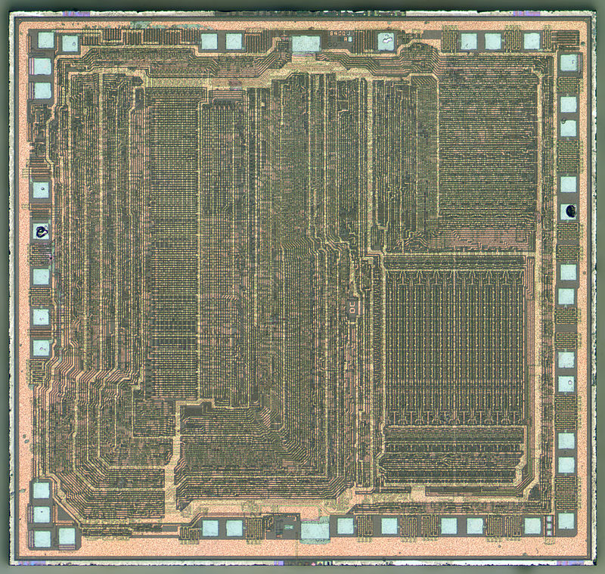
Z80 Design
Notes:
Here is the silicone design - ROM magazine Centerfold

Slide 6
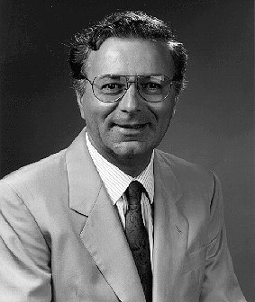
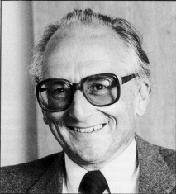
Faggin
Notes:
Federicco Faggin - Check Peddle
Peddle recognized a market for an ultra-low-price microprocessor and began to champion such a design to complement the $300 Motorola 6800.
CEO Federico Faggin was actually heavily involved in the chip layout work, together with two dedicated layout people. Faggin worked 80 hours a week in order to meet the tight schedule given by the financial investors, according to himself

Slide 7
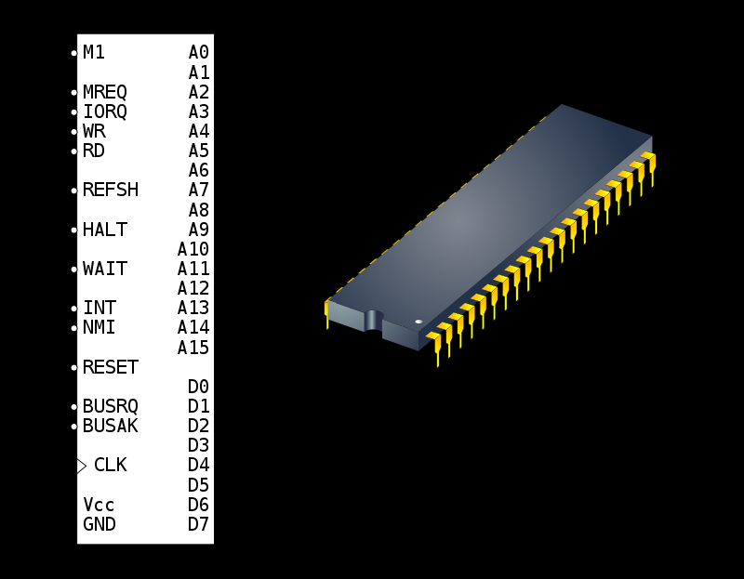
The Z80 Package (DIP40)
Notes:
Faggin designed the instruction set to be binary compatible with the Intel 8080

Slide 8
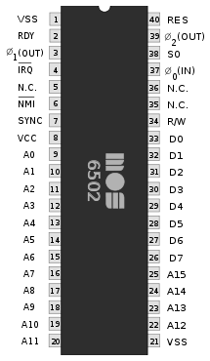
Zilog Z-80A vs. MOS 6502
Notes:
Pin outs of both processors

Slide 9
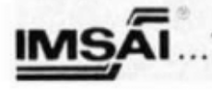
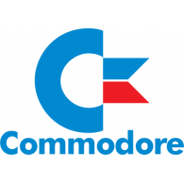
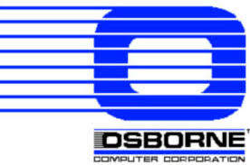
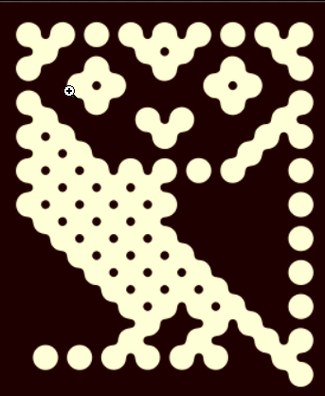
A few uses of the Zilog Z80
Notes:
Where is the Z80 used
Xerox 820
BBC Micro
Nec V20 and V30 - Chips had an emulation mode CP/M 86

Slide 10
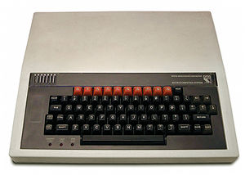
BBC Micro – Acorn Computers

Slide 11
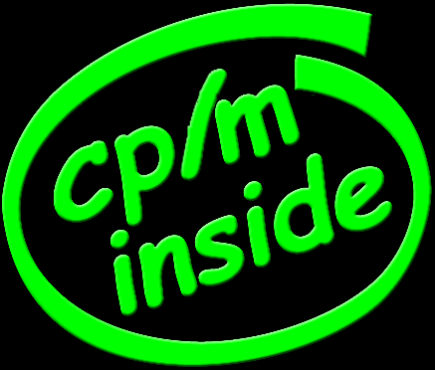
CP/M History

Slide 12
Control Program for Microcomputers
Created for the Intel 8080/8085
Gary Kildall – Digital Research
Single Tasking, 64K RAM,8-Bit
MITS Altair
Displaced by MS-DOS early 1980s

Slide 13
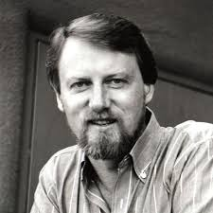
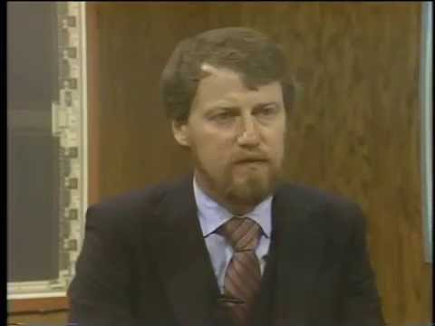
Gary Kildall
Notes:
Born in Seattle Washington
Attended the University of Washington pursuing teaching mathematics
Worked at Intel as a consultant on the 4004
Developed the first high level programing language called PL/M - CP/M created that same year
Demoed CP/M to intel, but they had little interest and chose to market PL/M instead.
Intergalactic Digital Research later renamed Digital Research
By 1982 CP/M was running on 3,000 different hardware platforms (Apple was one of them)
PC DOS story - Patent Infringement DOS $40 CP/M $240.00
After CP/M ------
GEM
Computer Chronicles
Novell Acquired DRI in 1991 netting him millions (DR-DOS)
Mystery surrounds his death in 1994

Slide 14
CP/M
Developed in 1974
Large Library of Software
MS-DOS or CP/M?
Drive Letters
8.3 filename
Wildcard Characters (* and ?)
Device Names (PRN: and CON)
Control-Z

Slide 15
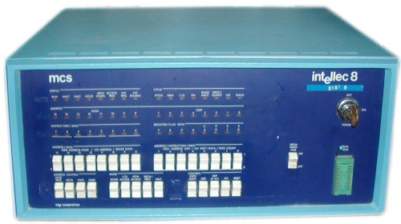
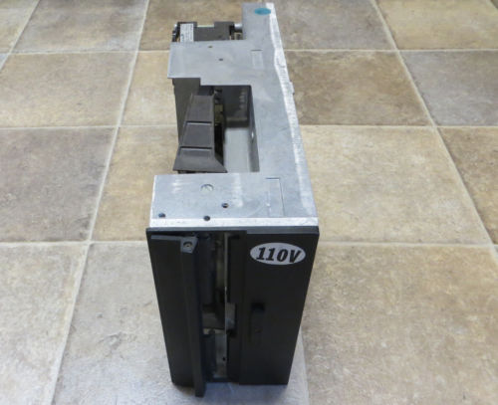
Intel Intelec-8
Notes:
Gary Kildall originally developed CP/M during 1974,^{[3][4]} as an operating system to run on an Intel Intellec-8 development system, equipped with a Shugart Associates 8-inch floppy disk drive interfaced via a custom floppy disk controller

Slide 16
Commercial Software Titles
Programming Languages
COBOL (Microsoft)
Fortran (Microsoft)
C (Aztec)
Pascal (Borland)
Modula 2 (Borland)
ADA (Janus)
MUMPS
BASIC (Various – CBASIC MBASIC)

Slide 17
Commercial Software Titles
Word Processor
WordStar
TEX
T/Maker
Magic Wand Word Processor
Notes:
Seymour I. Rubinstein

Slide 18
Commercial Software Titles
Database
dBase II
WHATSIT – “Wow! How did they get all that stuff in there”
Business Software
Microsoft MultiPlan
SuperCalc
Notes:
a free-form database that's really pretty clever for it's time (1975).

Slide 19
Commercial Software Titles
GAMES?
NEMISIS (D&D Like Game)
Sargon Chess
ZORK I, II, and III
Numerous BASIC Games
Notes:
a free-form database that's really pretty clever for it's time (1975).

Slide 20
CP/M
Three Components
BIOS - Basic Input/Output System
BDOS - Basic Disk Operating System
CCP – Console Command Processor
Came with Debugging Tool
DDT
Notes:
BIOS
provided the lowest level functions required by the operating system.- Drivers
BDOS
provided access to such operations as opening a file, output to the console, or printing.
CCP
patterned after the operating systems from Digital Equipment, such as RT-11 for the PDP-11 and OS/8 for the PDP-8
DDT
Dynamic Debugging Tool, - Pesticide

Slide 21
CP/M Versions
Version 1.4 - first public version
Versions 2.2 and 3.0
Unique Apple Versions
CP/AM 4.0
CP/AM 5.1
ProDOS Support
Notes:
Version 1.4
In this version the BDOS has been divided into two parts: a main PL/M body, and a “BDOS Interface Module” written in assembly language.
This is the first version that didn’t require a mainframe computer to build. Compilation and assembly was done on Intel development systems running ISIS, which had a PL/M compiler and a macro assembler.
For this version we only have the BDOS source code, in its two parts.
Version 2.0
Version 2.0 considerably expanded and generalized access to disks. There could be up to 16 logical drives with 8 MB each, as specified by a “disk parameter block”. Files could be spread over up to 512 extents. There was also a new concept of users with “user numbers”, whose files are kept separated.
The source code of this version, thanks to former Digital Research VP of Engineering Tom Rolander, is a scan of the source code listing released by the company in 1979.
We also have machine-readable source code for most of the files. We suspect they have been retyped from the listing, so they may have errors, but spot checks are encouraging about their accuracy.

Slide 22
CP/M vs DOS Command Comparison
CP/M Command | MS-DOS Command
DIR [d:][filespec]* | DIR [d:][path][filespec]
TYPE filespec* | TYPE filespec
ED input-filespec [output-filespec] | EDLIN
ERASE filespec [CONFIRM]* | DEL filespec /Y
PIP [destination] [source] | COPY [source] [destination]
RENAME new-filespec=old-filespec* | REN old-filespec new-filespec
SUBMIT filesepc.SUB | RUNME.BAT or RUNME.CMD
USER n* | CD [path]
STAT | CHKDSK (kind of)

Slide 23
Why the Apple II?
Paul Allen’s Idea
Developed by Tim Patterson and Bill Gates
Simplify porting of Microsoft’s Languages
Demonstrated at West Coast Computer Faire 1980
Microsoft’s Largest Revenue Source 1980
Notes:
Don Burtis of Burtronix redesigned the SoftCard for Microsoft^{[6]} to improve its speed and provide better integration with the Apple II architecture.
ts original purpose was to simplify portingMicrosoft's computer-language products to the Apple II
selling 5,000 units in three months at $349 each, ($1,067.28 in 2018 dollars)

Slide 24
Apple II Z80 Hardware Options
Type #1
SoftCard Style
Microsoft was the first
Suspends the 6502 via DMA line
Takes over the bus
Has direct access to Apple II hardware

Slide 25
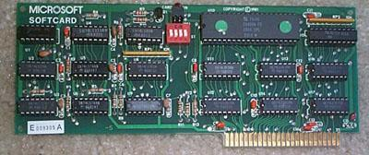
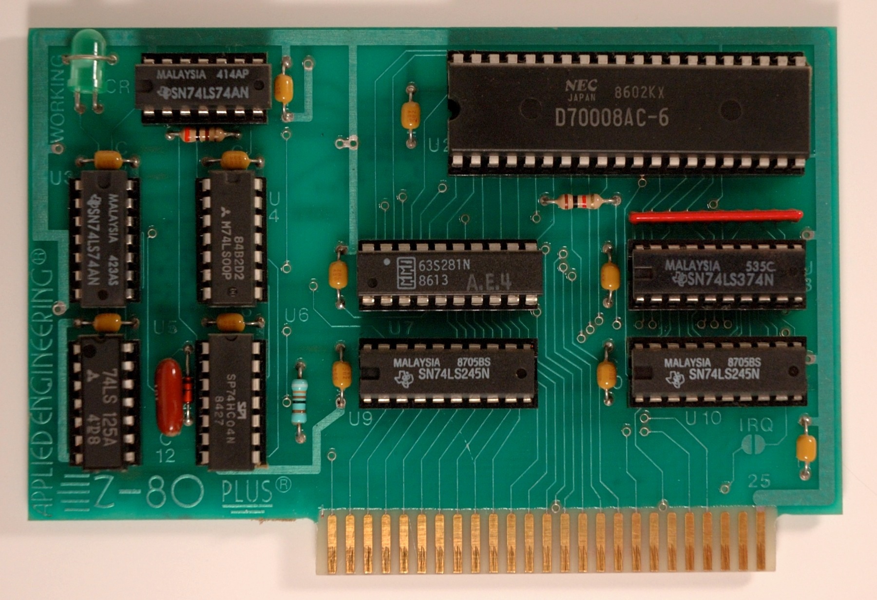
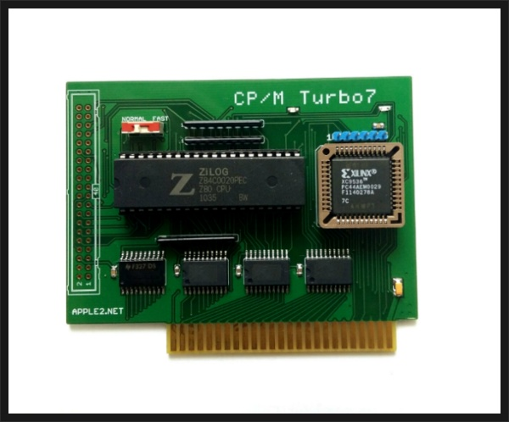
Examples of SoftCard Style
Microsoft’s
Z80 SoftCard
Applied Engineering’s
Z-80 PLUS
Ian Kim’s
Turbo 7
SoftCard Clone

Slide 26
Apple II Z80 Hardware Options Cont’d
Type #2
Single Board Computer (SBC)
Function independently of the 6502
Onboard RAM
Z80 is clocked between 4-6 MHz
No direct access to Apple hardware
AUX or Normal Slot

Slide 27
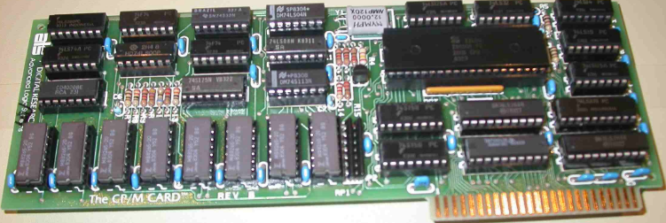
Examples of SBC
Personal Computer Peripherals Inc.
Appli-Card
Microsoft’s
SoftCard //e
Advanced Logic Systems
“The CP/M Card”

Slide 28
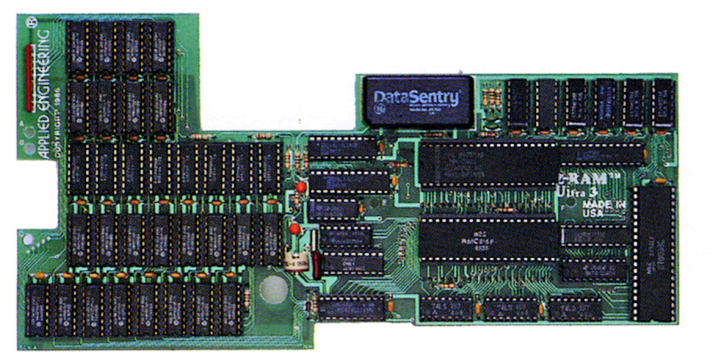
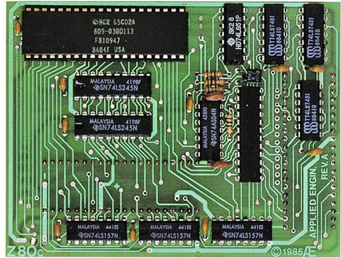
The Apple IIc Options
Applied Engineering
Z-RAM Ultra 3
Applied Engineering
Z-80C
Notes:
Z-RAM Ultra III
• Optional 65C816 16-bit processor plugs right in with no component changes
Z-80C
Cirtech also made a module

Slide 29
Apple CP/M – Getting Started
Choose your Hardware (Emulator)
Get the correct version of CP/M
Make Boot Disks (PIP)
Download Software
Hard Drive?
Read the CP/M user guide

Slide 30
Quick Demo

Slide 31
Awesome Apple II CP/M Site
https://pitt.box.com/v/CPM

Slide 32
More Information
http://roger.geek.nz/apple2/cpm.html
https://www.atarimagazines.com/creative/v10n1/100_The_PCPI_AppliCard.php
http://quick09.tistory.com/category/%E2%97%86%20My%20Z80%20Card
http://www.digitalresearch.biz/index.htm
http://www.computerhistory.org/atchm/early-digital-research-cpm-source-code/
http://www.computerhistory.org/atchm/computer-history-museum-license-agreement-for-the-kildall-manuscript/
http://apple2online.com/index.php?p=1_49_CPM-Library
http://www.callapple.org/soft/ap2/acpm.html
http://www.classiccmp.org/cpmarchives/
https://www.chiark.greenend.org.uk/~jacobn/cpm/cpmfiles.html#A201

